Slide 1
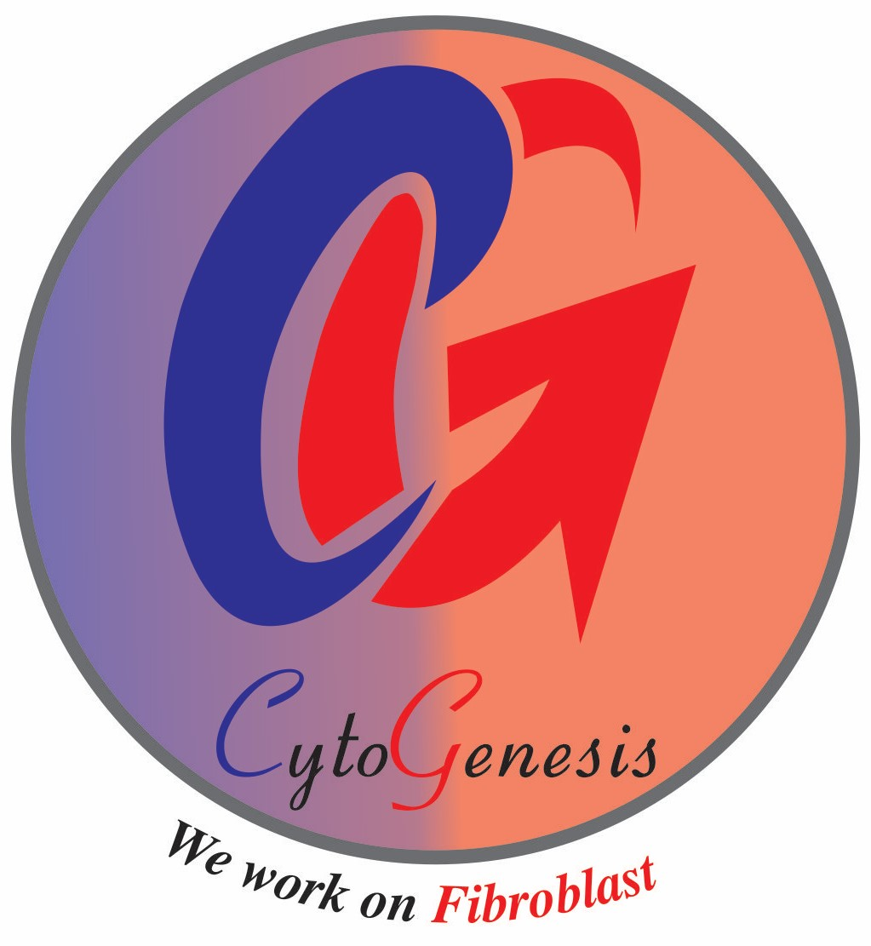
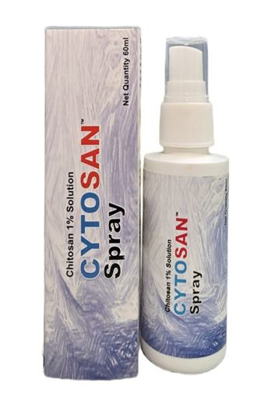


CytoGenesis Pvt Ltd Launched A Powerful Cation+ to treat the Acute/Chronic Wound. We committed to Prevent Amputation
Now Available CYTOSAN 1% Spray (Chitosan 1%)
Our Next Arrival
CYTOSAN Gel
XTRA POWERED CATION
The Cation CYTOSAN 1% Spray offers Rapid granulation due to its Cation+ charge. Cytosan Facilitate Autolytic debridement, Biofilm Disruption, Broad spectrum Anti-Microbial, Collagen Synthesis & Hemostatic CYTOSAN also Posses Biocompatibility, Biodegradability Anti-inflammatory Property

